Slide 1
Using Your ACT and SAT Data
Frenship High School
Kim Spicer, Principal
Bonnie Thompson, College Readiness Coordinator

Slide 2
What is College Readiness?
The Level of preparation a student needs in order to enroll and succeed – without remediation – in a credit-bearing general education course at a postsecondary institution. (Conley 2007)

Slide 3
How do we assess college readiness?
ACT
SAT
EXPLORE*
  8th Grade Assessment
PLAN*
  10th Grade Assessment
ACT*
  11th & 12th Grade Assessment
Redi Step
  8th Grade Assessment
PSAT*
  10th & 11th Grade Assessment
SAT*
  11th & 12th Grade Assessment
TSI Assessment*
  College Placement
*Assessments FISD currently uses

Slide 4
ACT Assessments

Slide 5
3 Assessments –
One Common Score Scale
 | 1 | 25 | 32 | 36
EXPLORE
PLAN
ACT

Slide 6
EXPLORE / PLAN
FISD Tests ALL 8th / 10th Grade Students
Testing occurs in the Fall Semester
Overview is given before and after the test
Teacher Meeting

Slide 7
EXPLORE / PLAN –
What’s on the score report?
Predicted PLAN / ACT Score
College Readiness Benchmarks
Students Self Selected Needs
Career Interest Inventory
High School Plans

Slide 8
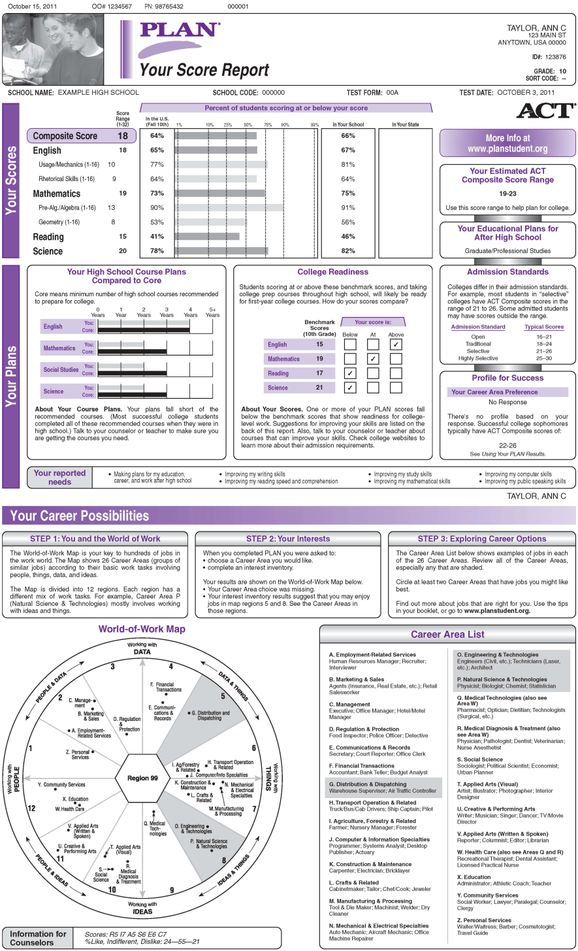
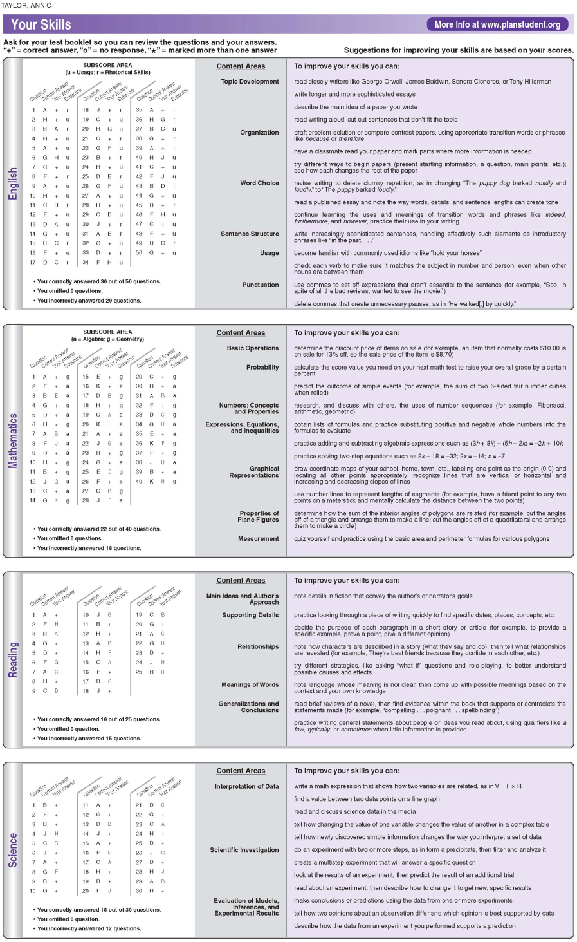

Slide 9
ACT
Test Prep Seminar
  During the School Day
    Student and School cost
Summer Scholars Academy
  Free to Students
  Week before the June ACT test
ACT / SAT Class
  One Semester – Open to 10th, 11th, and 12th Graders
Test Center
  FHS is a test center for the October, December, February, April, and June test dates

Slide 10
SAT Assessments

Slide 11
PSAT / NMSQT
Test all Freshmen and Juniors
  Available to Sophomores who sign up
Superintendent Select
  8th, 9th, and 10th grade students
Overview is given before and after the test
Teacher Meeting

Slide 12
PSAT –
What’s on the score report?
Students Scores and Percentiles
National Merit Scholarship Information
Skill Categories
Answers and Degree of Difficulty
Access Code To My College QuickStart

Slide 13
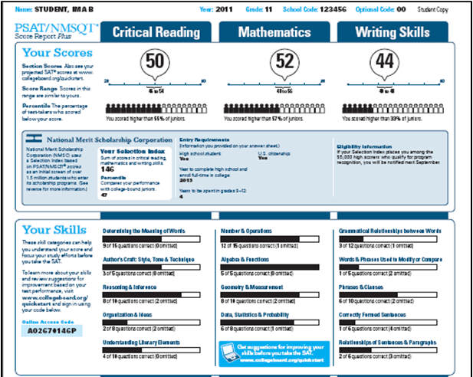
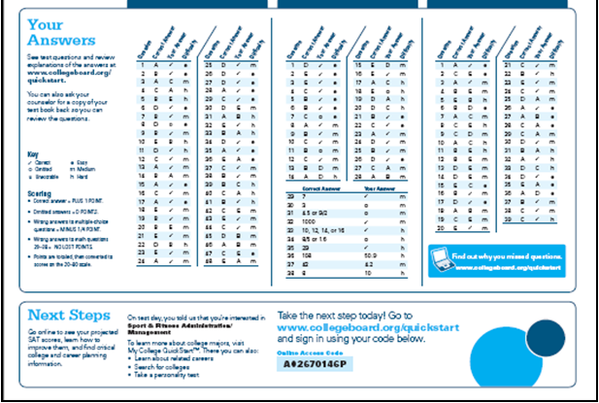

Slide 14
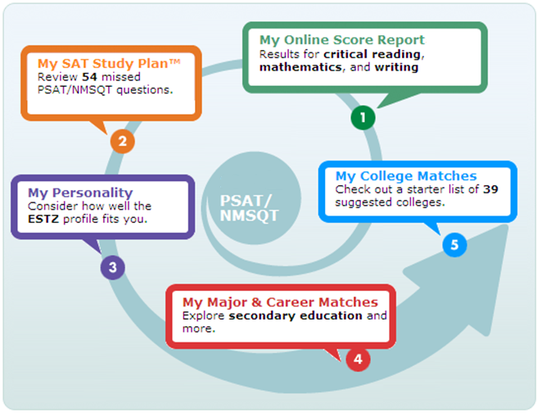
My College QuickStart

Slide 15
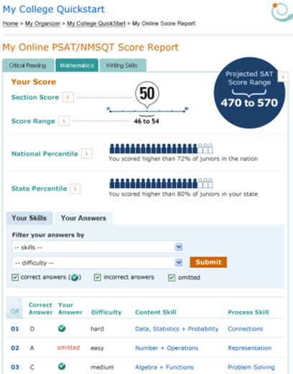
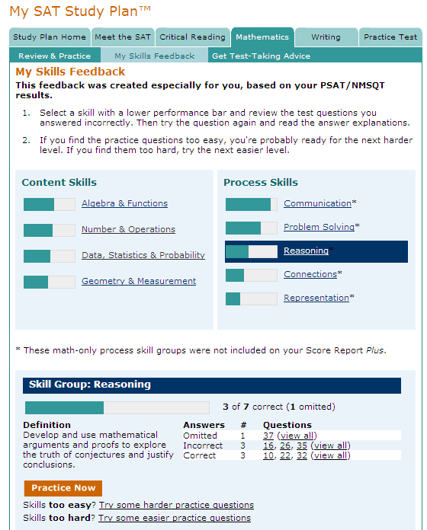

Slide 16
SAT
Test Prep Seminar
  During the School Day
    Student and School cost
Summer Scholars Academy
  Free to Students
  Week before the June SAT test
ACT / SAT Class
  One Semester – Open to 10^{th,} 11th, and 12th Graders
Test Center
  FHS is a test center for the October, December, January, May, and June test dates

Slide 17
Using The Data
EXPLORE / PLAN / PSAT

Slide 19
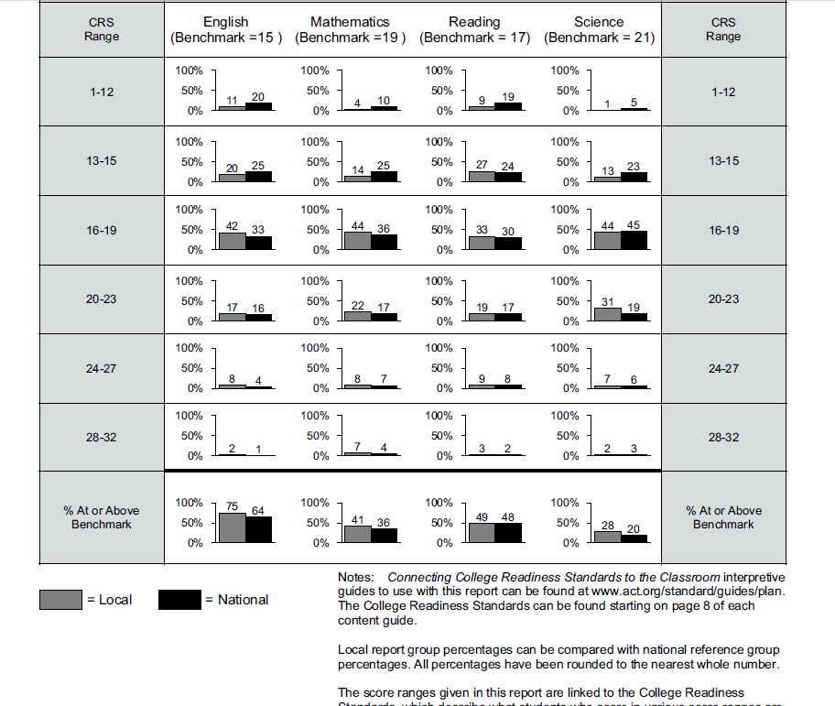
PLAN Profile Summary Report
To view the standards go to: www.act.org/standard/guides/plan/
College Readiness Standards (CRS) Range
% of students scoring in that range
% meeting the College Readiness Benchmark Score

Slide 20
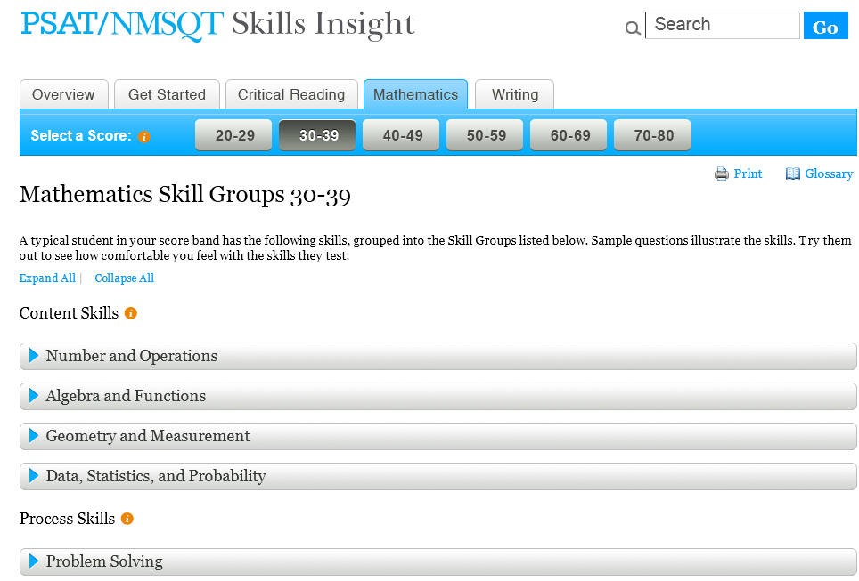

Slide 21
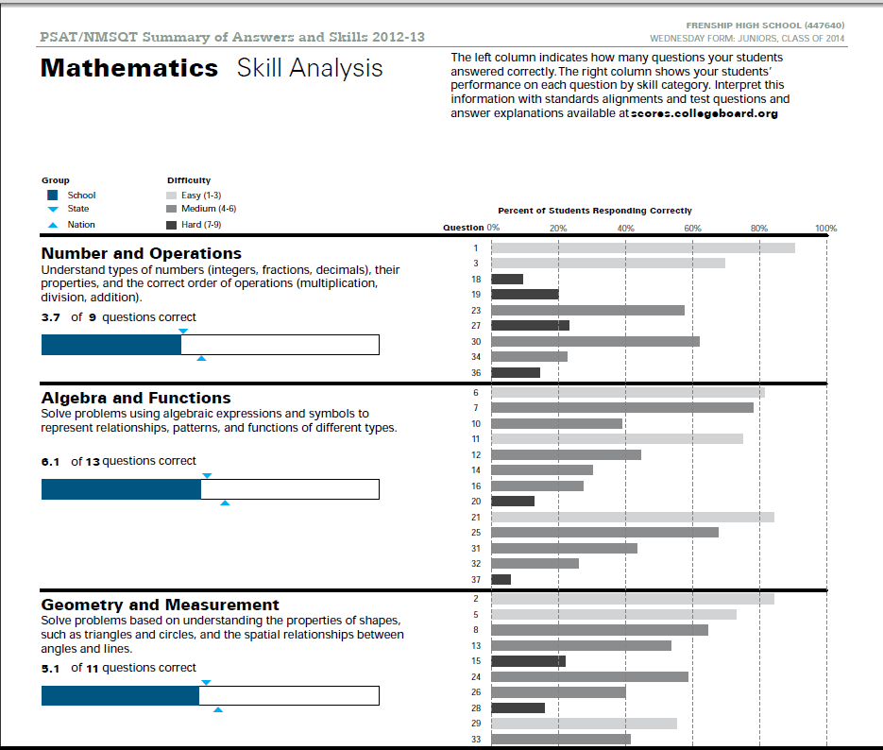
PSAT Summary of Answers and Skills
Difficulty Level
Skills that were tested (same as SAT)
How we did compared to the state and nation

Slide 22
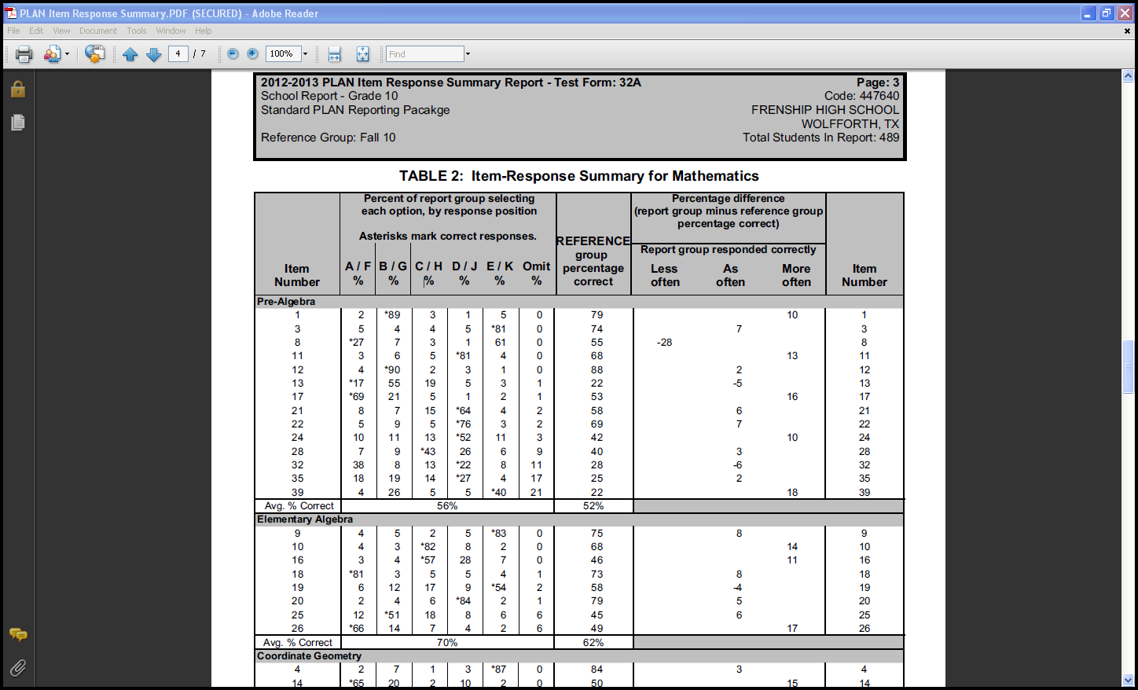
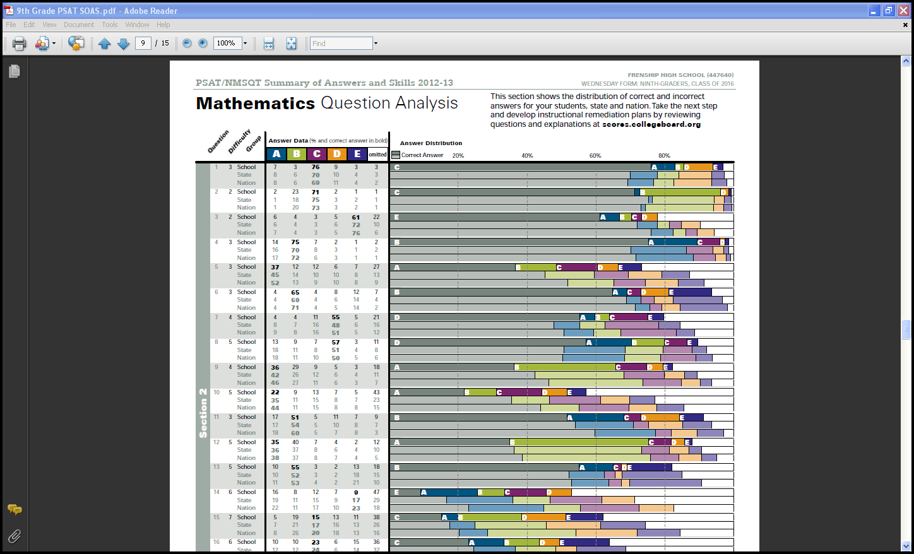
Look at the questions

Slide 23
How did we do on each question?
75-100%
25-49%
50-74%
0-24%

Slide 24
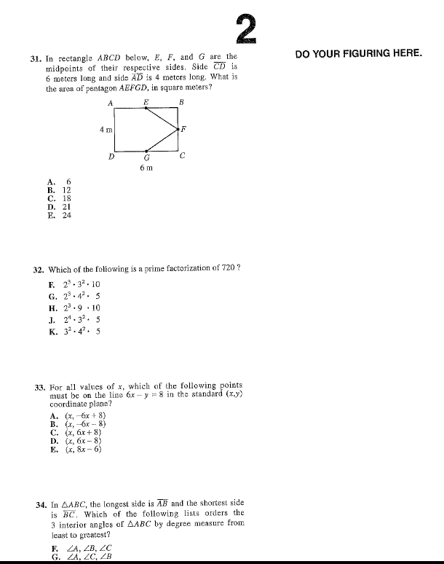
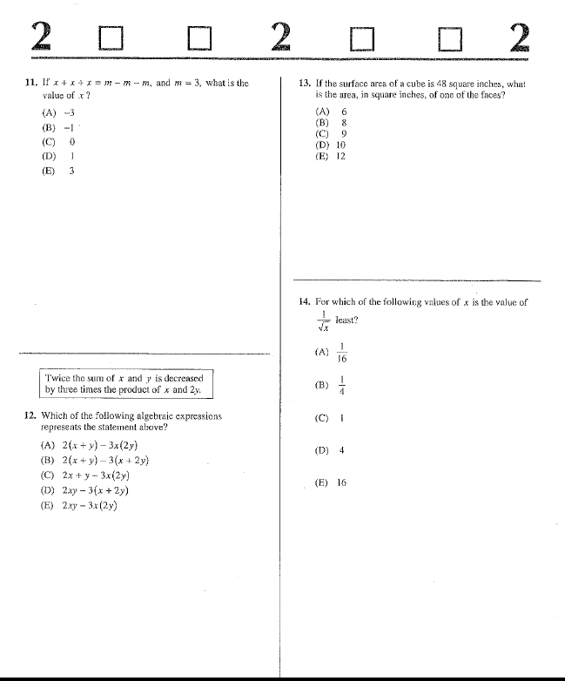
What questions do we need to work on?

Slide 25
Using the Data in the Classroom
Bell Ringers
Benchmark Testing (Geometry & Algebra 2)
  1 full class period – ACT
  1 full class period – SAT
  Response Report for each student
Testing Strategies

Slide 26
What else do we do to help students prepare for college and career readiness?

Slide 27
College and Career Night
Panhandle TACRAO Schedule
Over 50 Different College/Career/Military Recruiters
Mini-Financial Aid Fair
Invite Students & Parents Grades 9-12

Slide 28
College Transition Course
Originated from FHS Students
Students are given a local credit
  Seniors – Fall
  Juniors – Spring
Students leave having:
  Filled out applications
    Admissions, Scholarships, Housing
  Researched their top 3 choices
  Completed a degree plan
“Get it together for College” – CollegeBoard

Slide 29
Creating a Vision
Any student in grades 7th, 8th, 9th, & 10th can attend
Students tour:
  Texas Tech University
  South Plains College
1st week in June
No cost to the student

Slide 30
Dual Credit / Advanced Placement
Dual Credit
Advanced Placement
93 Dual Credit and Technical Credit Hours Offered
11 On Site Faculty Qualified to Teach Dual Credit
Associates Program
Weighted Classes
Biology, Calculus, Chemistry, Computer Science, English Lang., English Lit., Physics, Spanish, Statistics, Studio Art, US History
Tested off Site
Weighted Classes
Will also Count Towards Associates Program

Slide 31
Questions?
Kim Spicer
kspicer@frenship.us
Bonnie Thompson
bthompson@frenship.us

